Slide 1
Neighbourhood Analysis for finding Best Location to Open Fast-food restaurant

Slide 2

Project analysis slide 2
Introduction and Business Problem
A Customer and a friend of mine named Ravi, wants to open a Fast Food Restaurant in Durham Region, Ontario, Canada. There are 8 municipalities in Durham Region and each being Diverse, it is hard to locate the best location to open a restaurant. As this is going to be his biggest investment, he is looking to have this restaurant closer to schools, colleges and universities, looking to attract maximum customers.
Hence, we need to choose the best locality that has plenty of customers and least amount of competition.

Slide 3
Project analysis slide 3
Data
Exploration
Web-scraping Data From
Wikipedia Link
Collection and Preprocessing
Fetching Scraped Data from the Website and extract useful to process for analysis.
Fetching Coordinates for different locations From Foursquare for comparative analysis.
Processing and Analysis
Process data fetched from different sources like Foursquare and Wikipedia to compare different neighborhoods in Durham Region.
Create Analysis Report for best Neighborhood to Open Fast Food Restaurant
.

Slide 4
Project analysis slide 4
Project Methodology
For each locality, all offices, schools, universities and Fast Food restaurant venues data have been collected from Foursquare. Then for each locality, the sums of the office, school, university and fast food restaurants were computed.
For each of these categories, a weight (or penalty) has been defined accordingly to what Ravi considers most important.
Fast Food Restaurants have been weighted with -1, since Ravi wants to avoid concurrence.
Shopping Malls have been weighted with 1, since Shoppers mostly buy food from inside the mall but still considered good customers.
Schools have been weighted with 2, since student are good customers.
Universities have been weighted with 2, since students are good customers.
Offices have been weighted with 3, since employees are even better customers.
Note: that the weights can be modified according to the importance of each category.
Lastly, a score was computed for each locality as the weighted sum of the number of venues in each of the 5 categories (school, university, office, fast food restaurants, Shopping Malls).

Slide 5
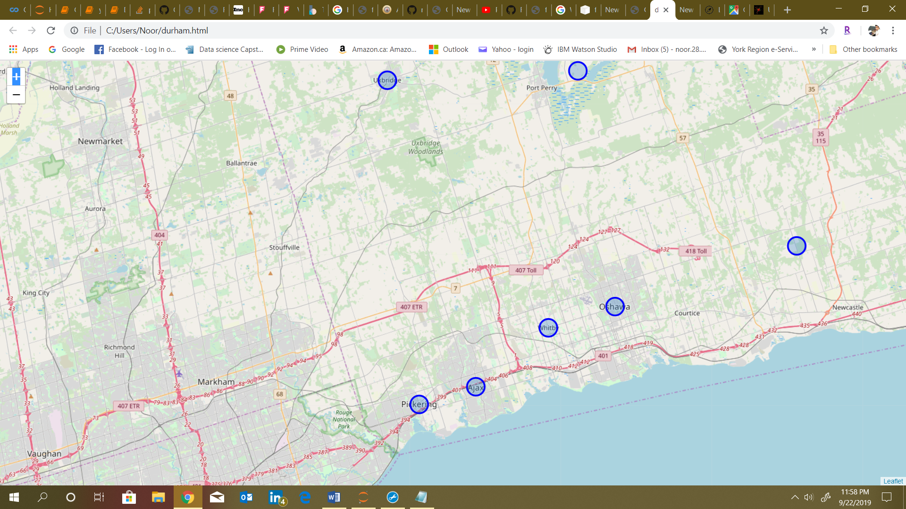
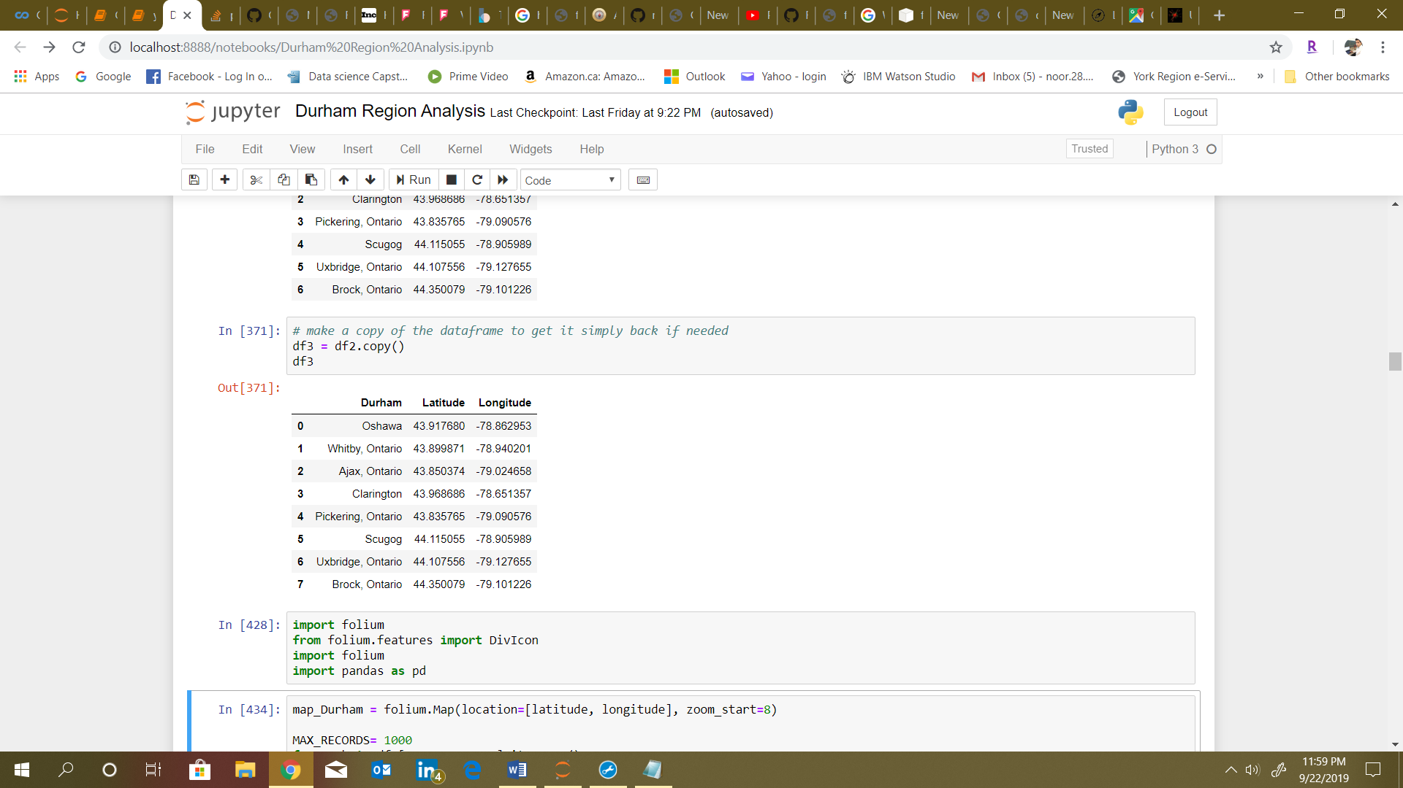
Project analysis slide 6
Municipalities of
Durham Region with Coordinates

Slide 6
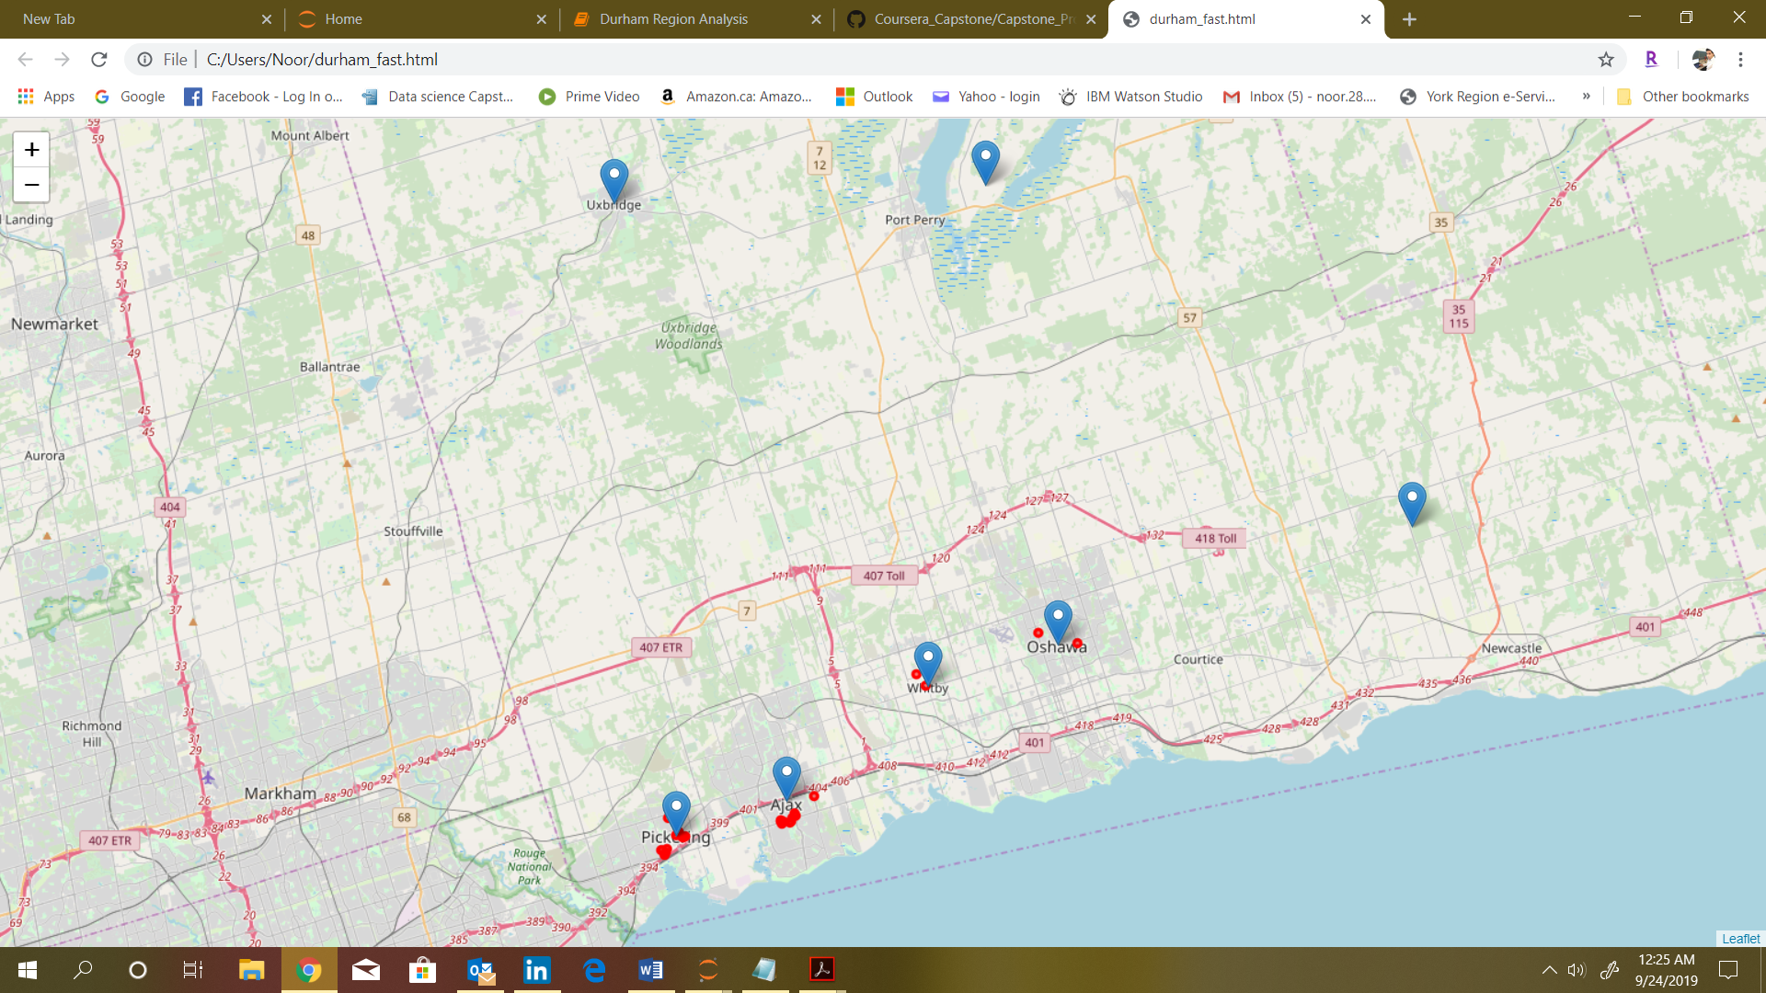
Project analysis slide 7
Fast Food Restaurants
in Durham Region

Slide 7
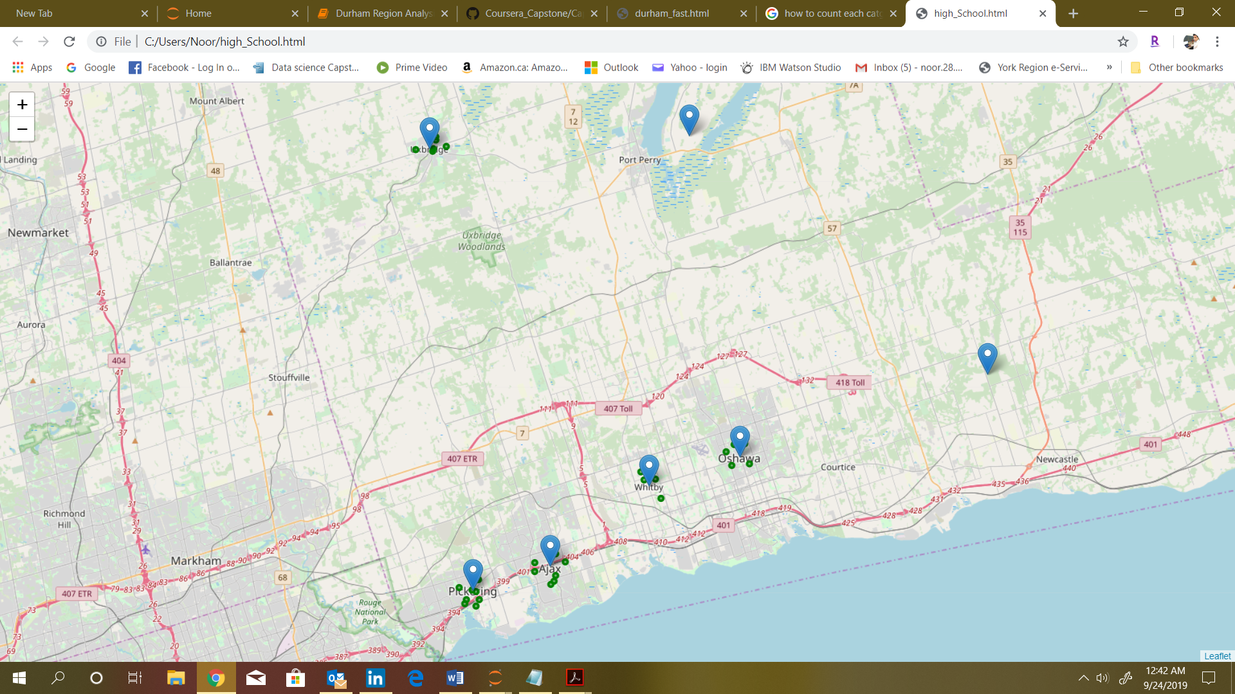
Project analysis slide 8
High Schools
in Durham Region

Slide 8
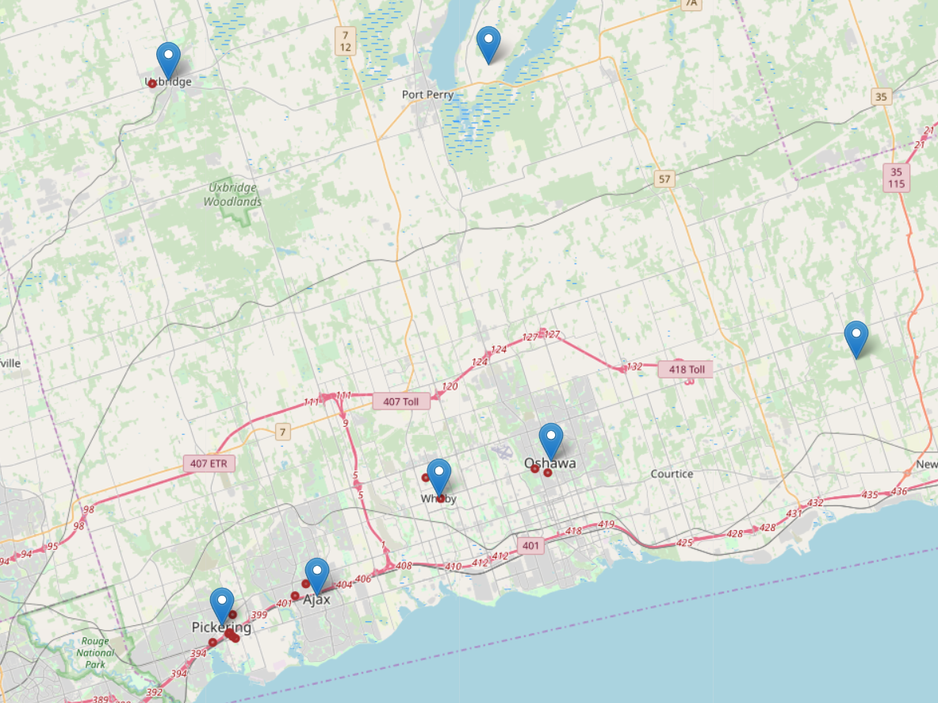
Project analysis slide 10
Colleges
in Durham Region

Slide 9
Project analysis slide 10
Colleges
in Durham Region

Slide 10
Project analysis slide 10
Businesses
in Durham Region

Slide 11
Project analysis slide 10
Businesses
in Durham Region

Slide 12
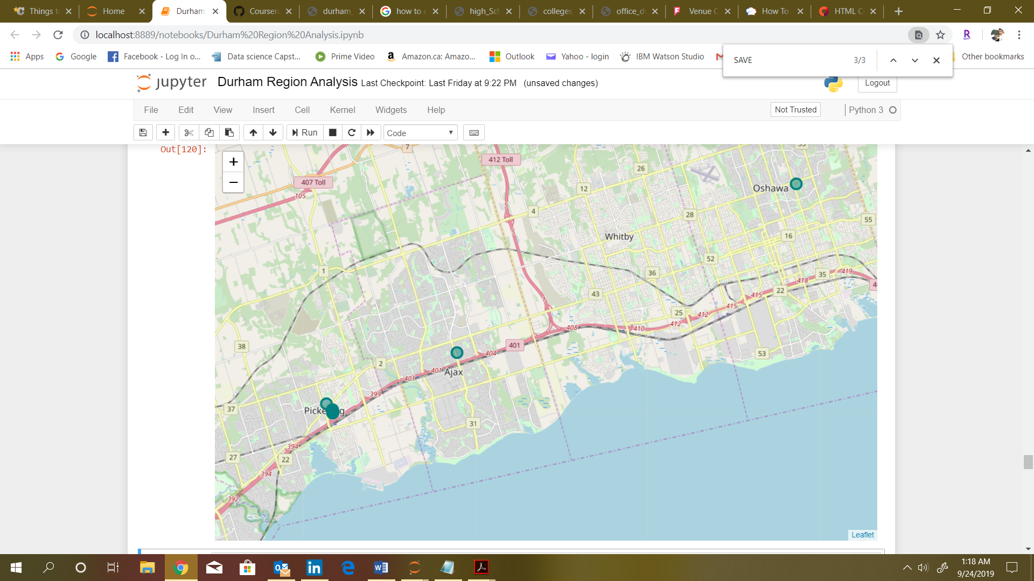
Project analysis slide 10
Shopping Malls
in Durham Region

Slide 13
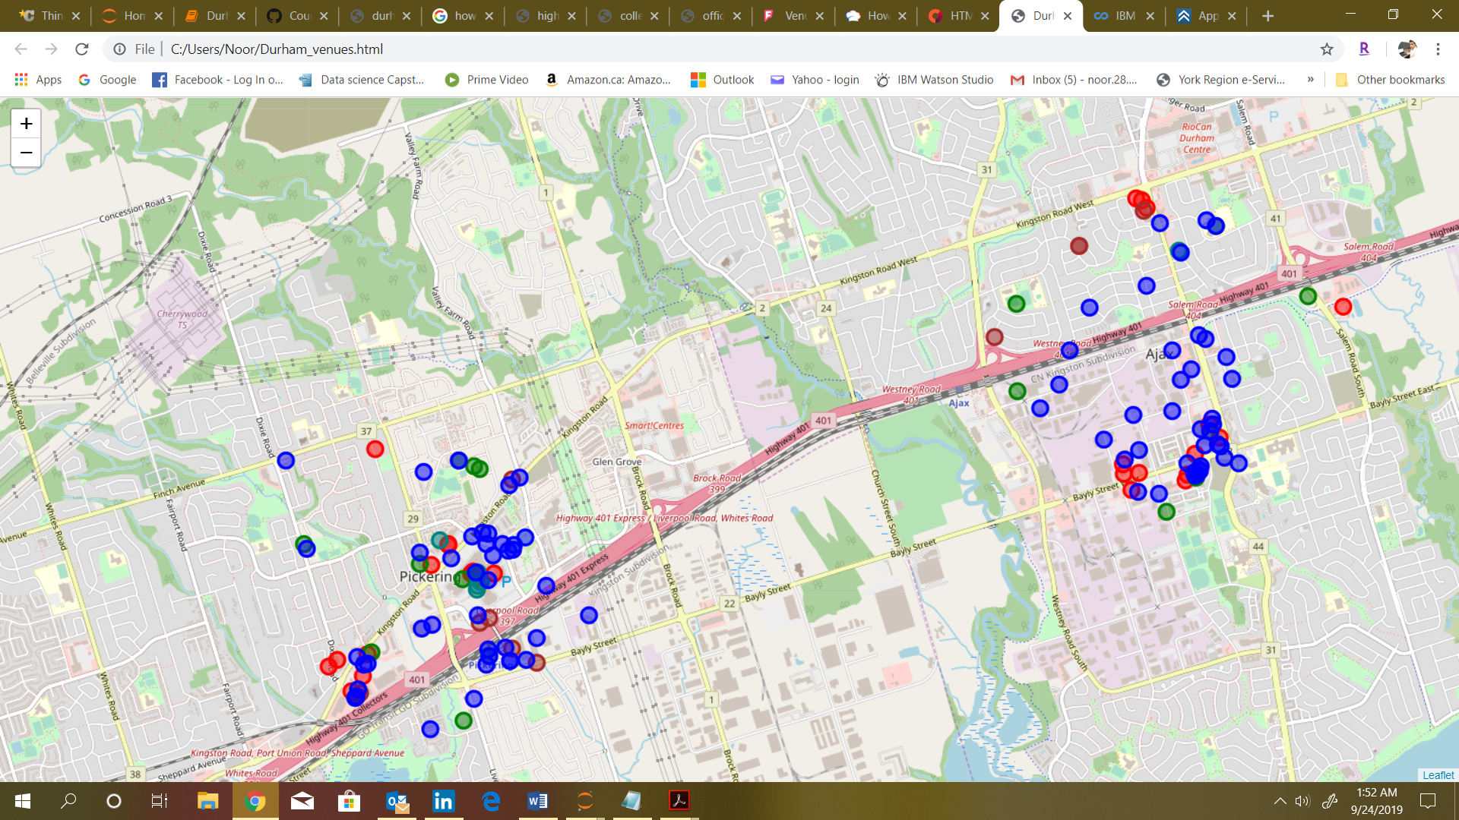
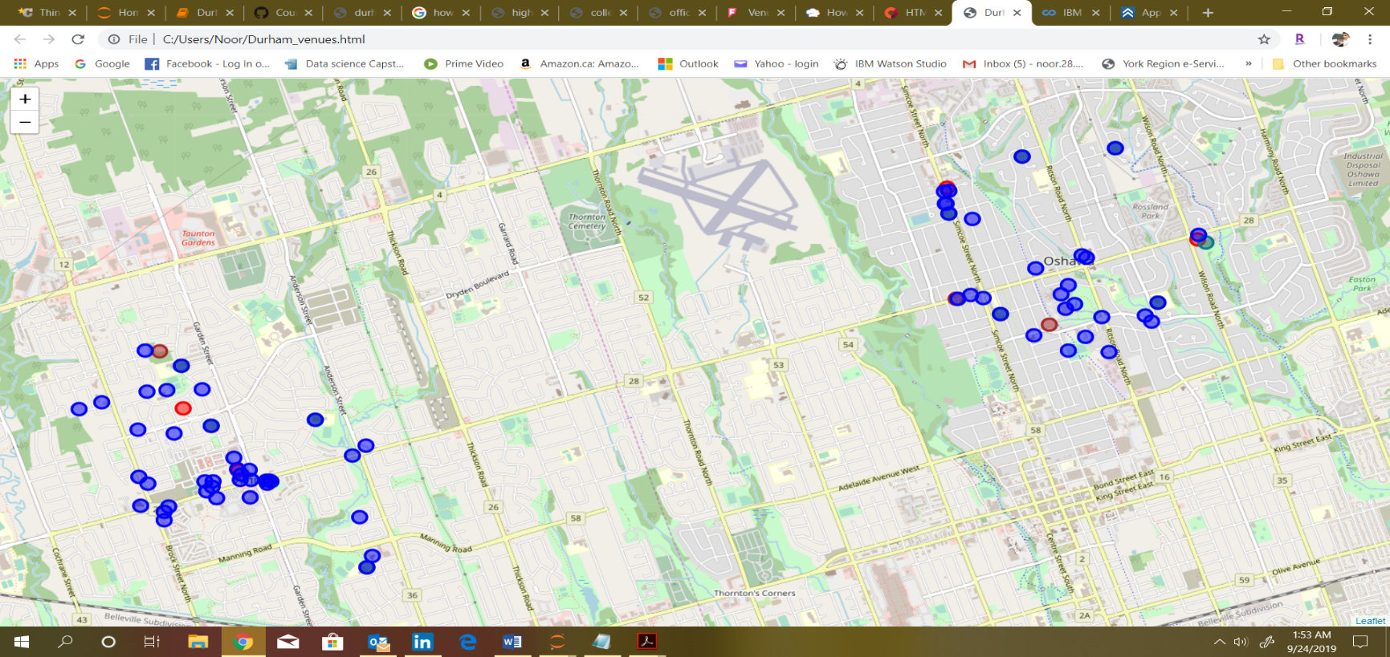
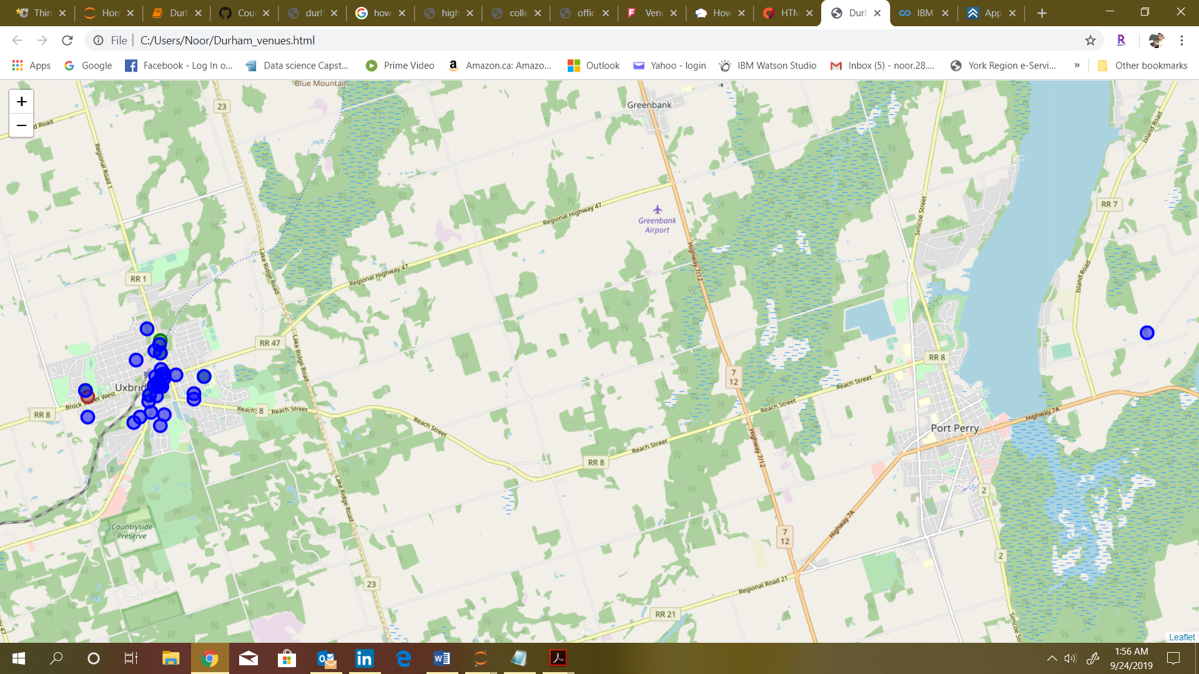
All of the Venues in Durham Region Donated By Color Coded Circles

Slide 14
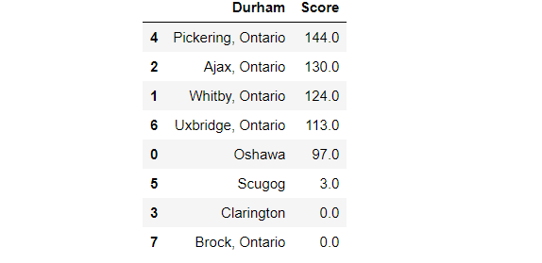
Results
Pickering, Ontario
Pickering, Ontario shows the best Locality to Open Fast Food restaurant in Durham Region with the Score of 144.
Next best comes Ajax, Ontario with close lagging to the Score of 130.
These Localities has maximum number of potential customers to attract from schools, universities, Businesses etc. and at the same time has not much competence.

Slide 15

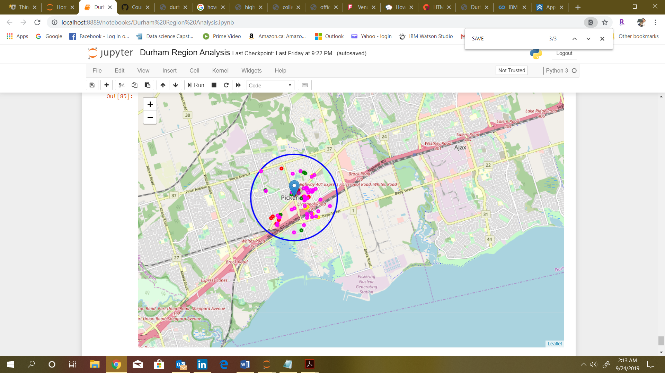
Best Location to Open a Fast Food Restaurant in Durham Region is Pickering Ontario. Map of the Municipality showing all the Venues located within the Locality and why this makes this City a preferred location than others.

Slide 16
Thank You

